Slide 1
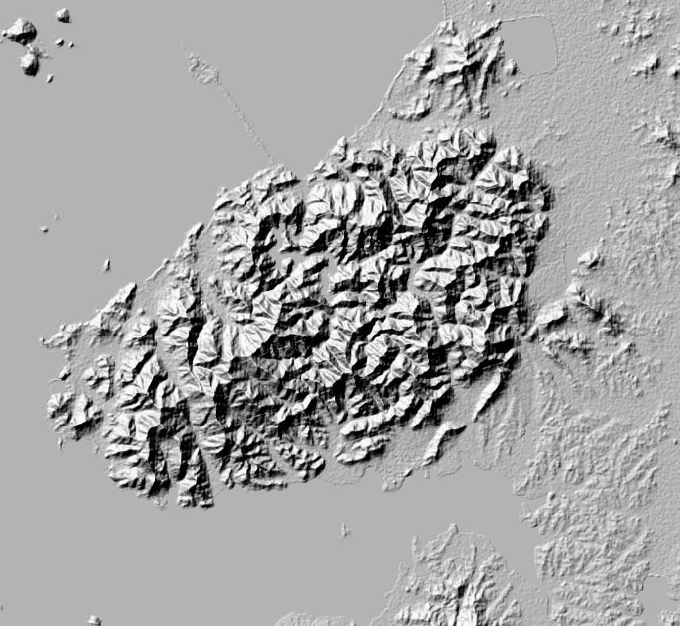
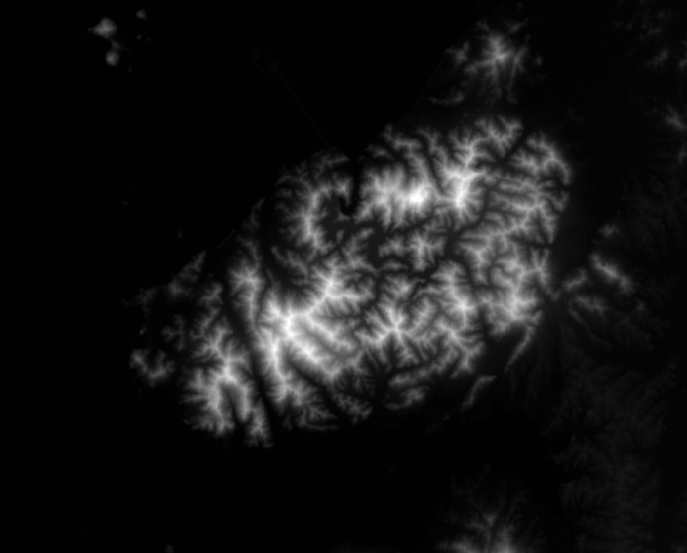

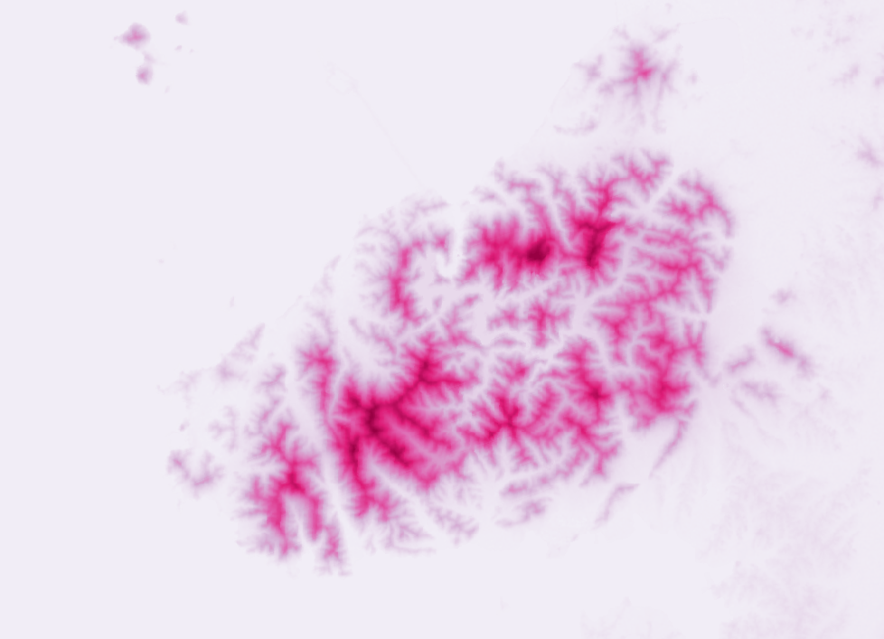
3주차
QGIS에서 DEM
데이터 스타일링

Slide 2
https://github.com/osgeokr/gistudy

Slide 3
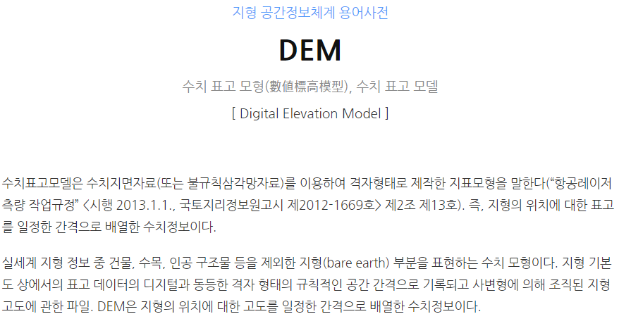
https://terms.naver.com/entry.nhn?docId=3475248&cid=58439&categoryId=58439

Slide 4
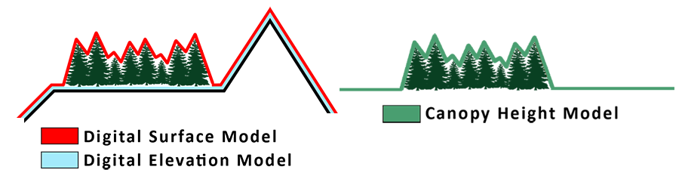
gsp.humboldt.edu/OLM/Courses/GSP_216_Online/lesson7-1/applications.html

Slide 5
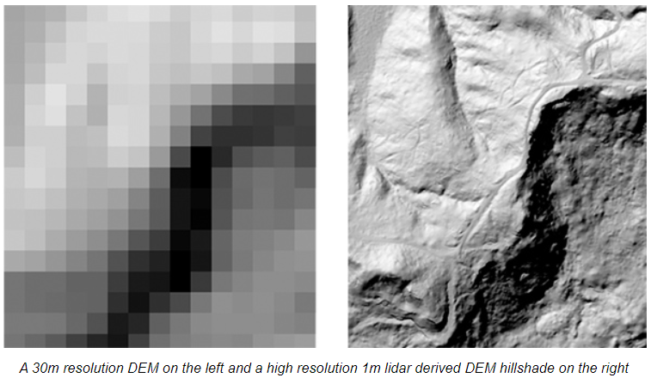
gsp.humboldt.edu/OLM/Courses/GSP_216_Online/lesson7-1/applications.html

Slide 6
3주차
QGIS에서 DEM
데이터 스타일링

Slide 7
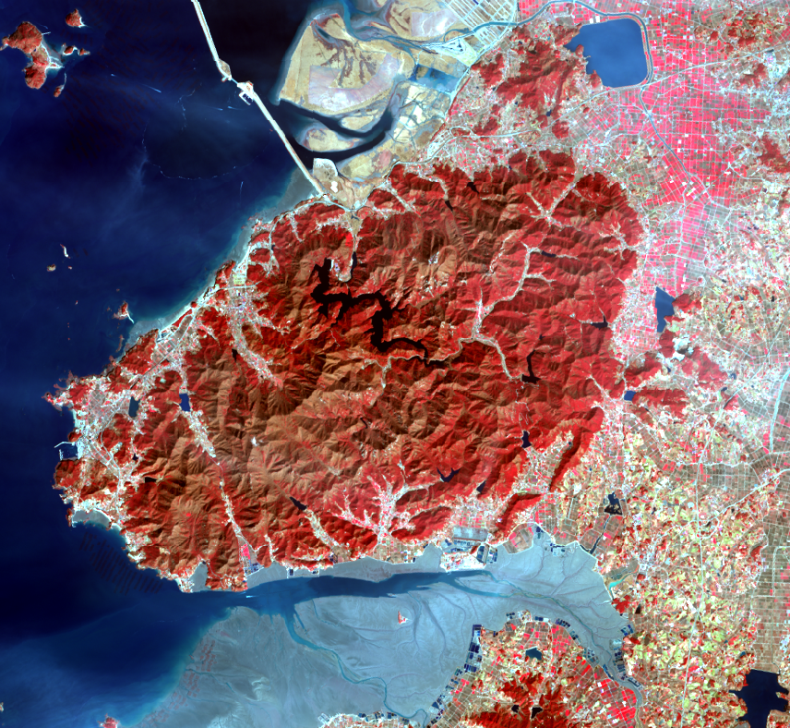
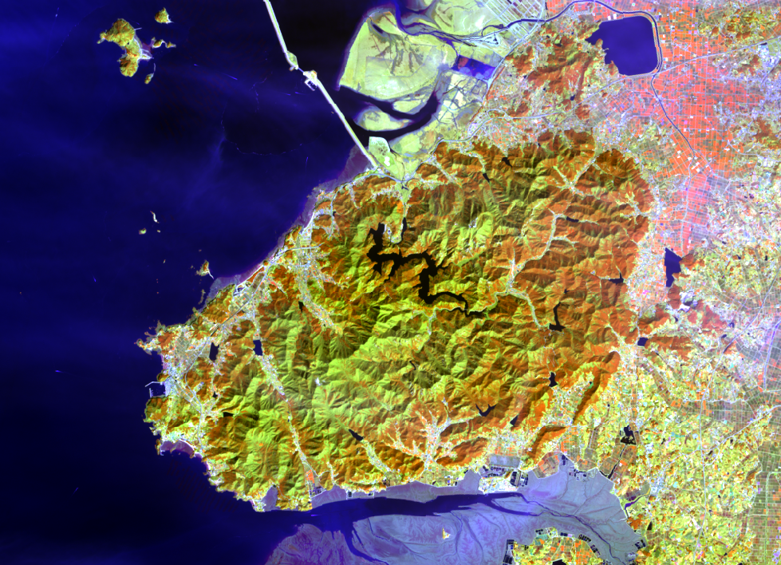
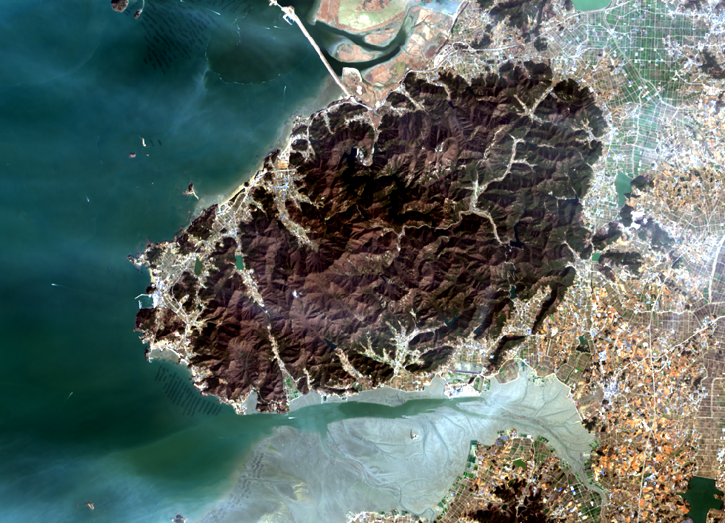
3주차
QGIS에서
위성영상 스타일링

Slide 8
https://github.com/osgeokr/gistudy

Slide 9
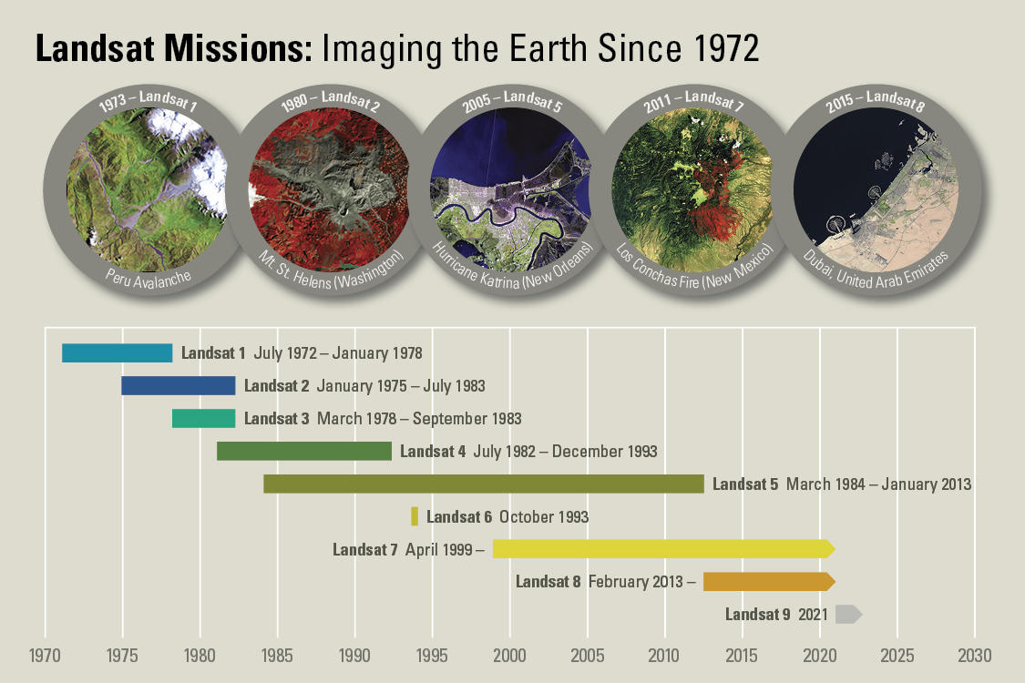
https://www.usgs.gov/media/images/landsat-missions-timeline

Slide 10
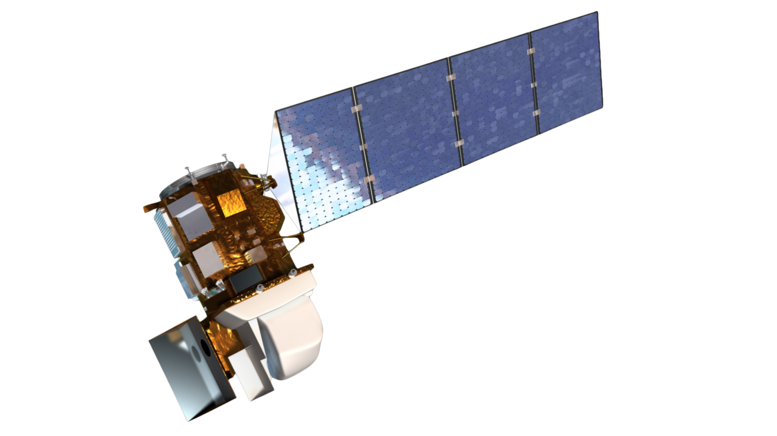
https://landsat.gsfc.nasa.gov/wp-content/uploads/2013/01/ldcm_2012_COL.png

Slide 11
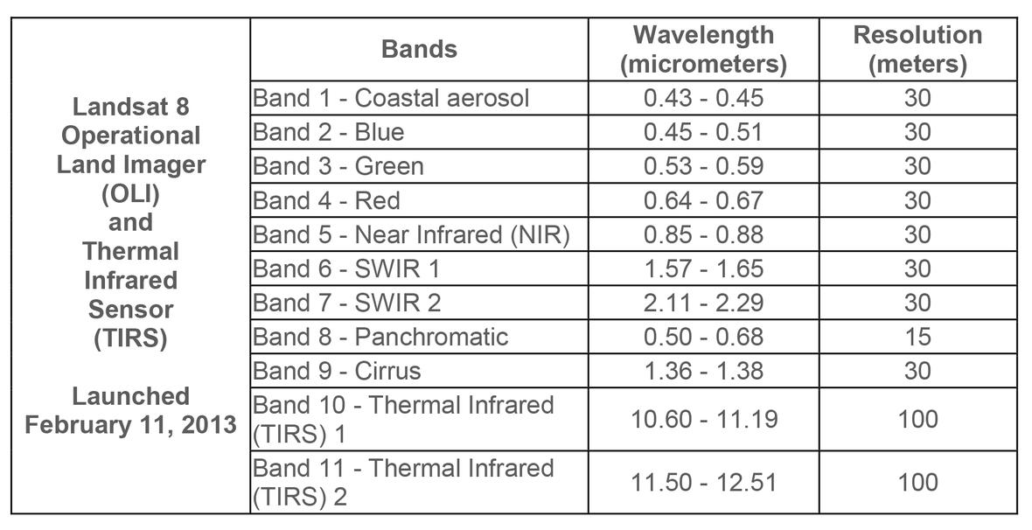
https://www.usgs.gov/media/images/landsat-8-band-designations

Slide 12
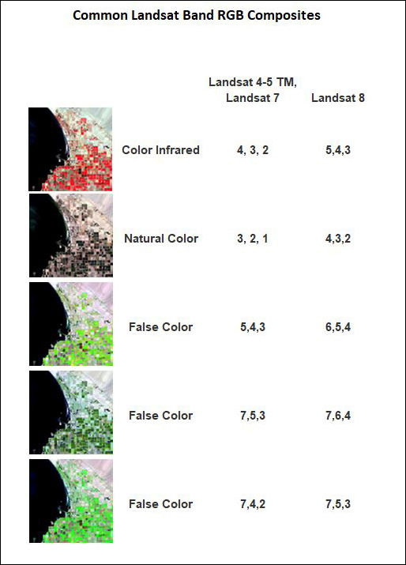
https://www.usgs.gov/media/images/common-landsat-band-rgb-composites

Slide 13
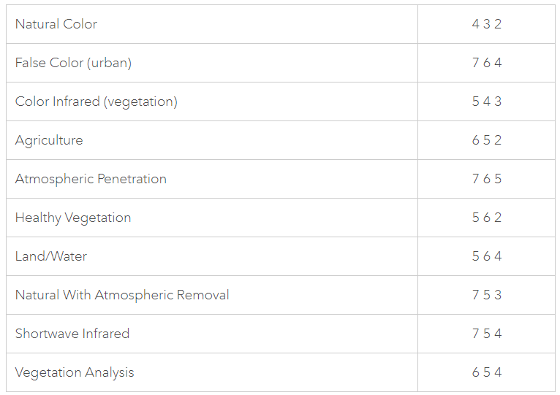
https://www.esri.com/arcgis-blog/products/product/imagery/band-combinations-for-landsat-8/

Slide 14
3주차
QGIS에서
위성영상 스타일링

Slide 15
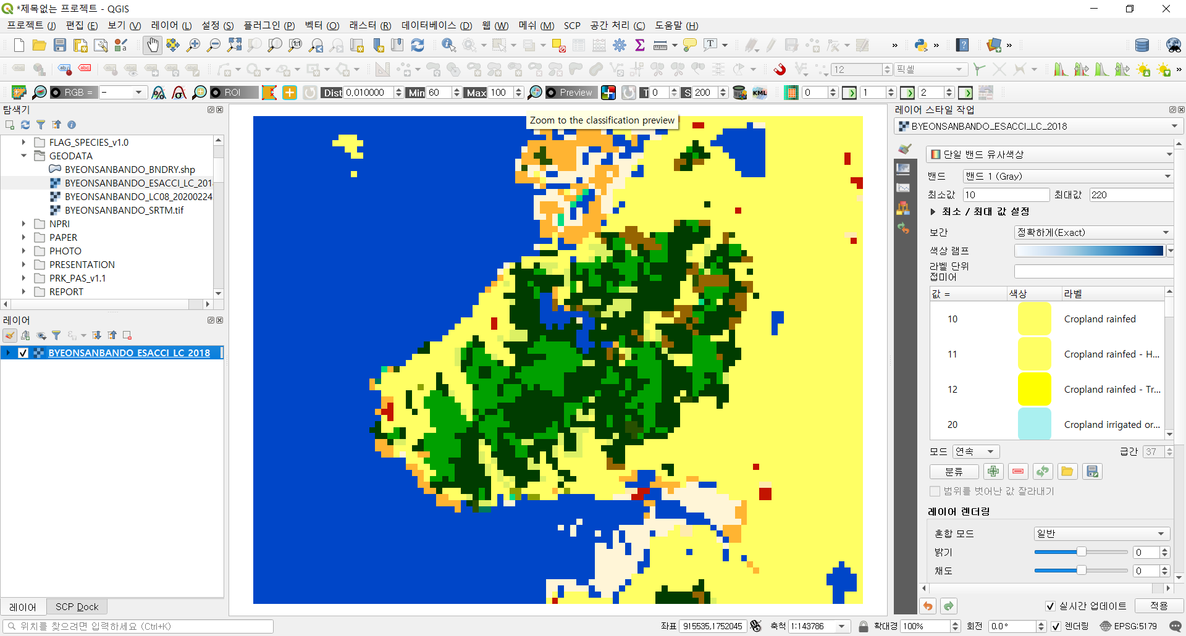
3주차
QGIS에서
토지피복도 스타일링

Slide 16
https://github.com/osgeokr/gistudy

Slide 17
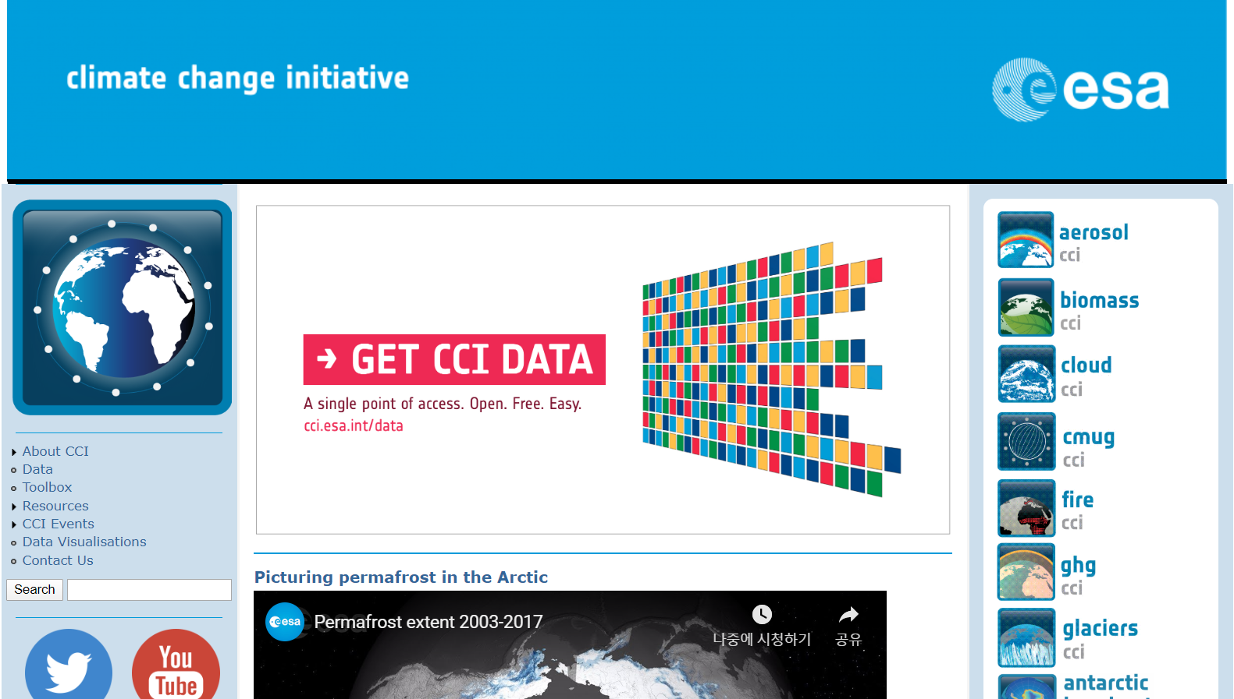
http://cci.esa.int/

Slide 18
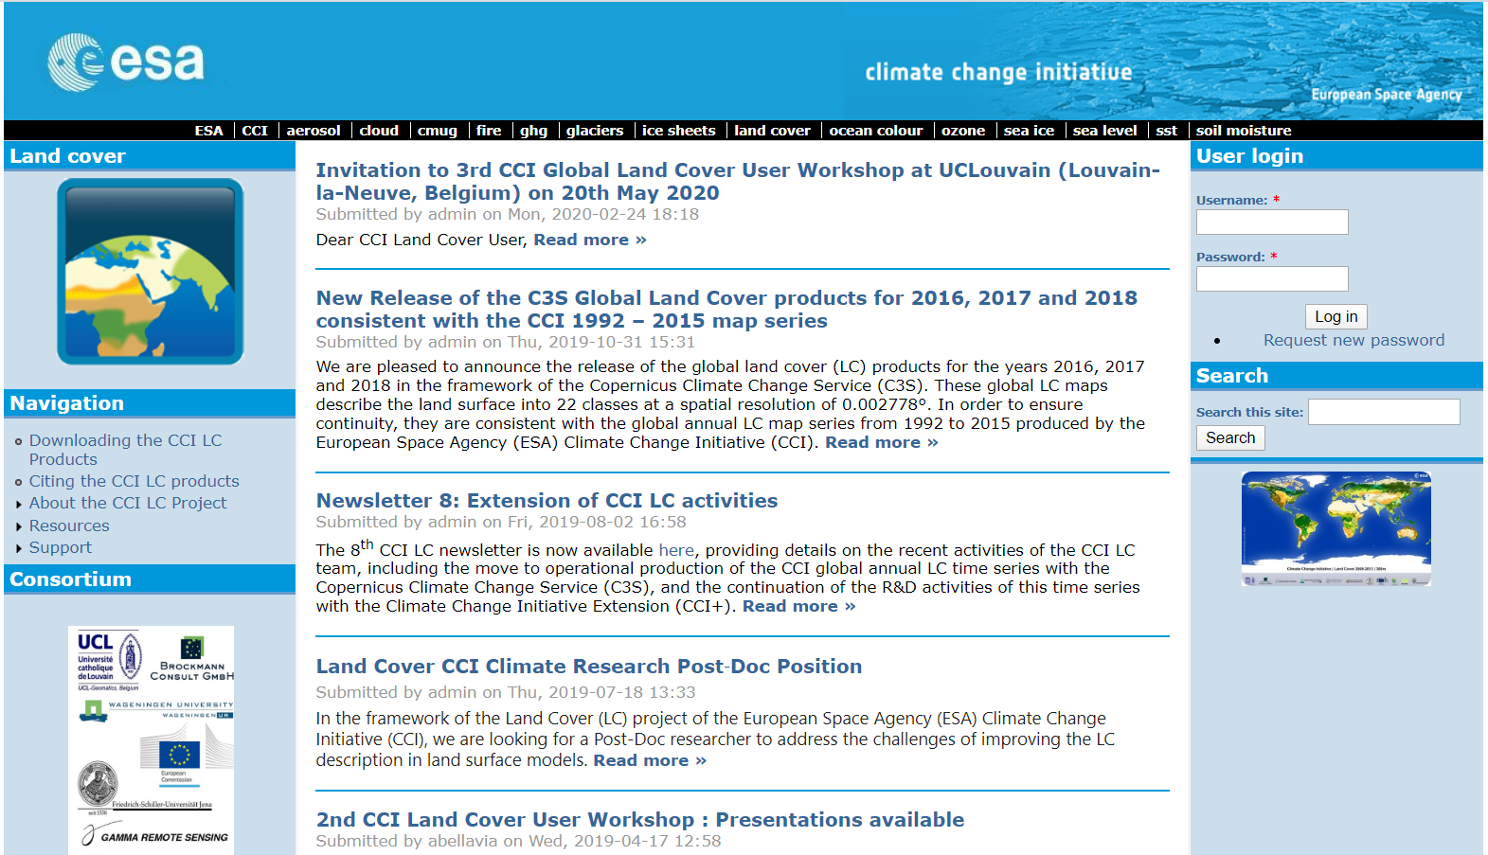
https://www.esa-landcover-cci.org/

Slide 19
3주차
QGIS에서
토지피복도 스타일링

